Slide 1
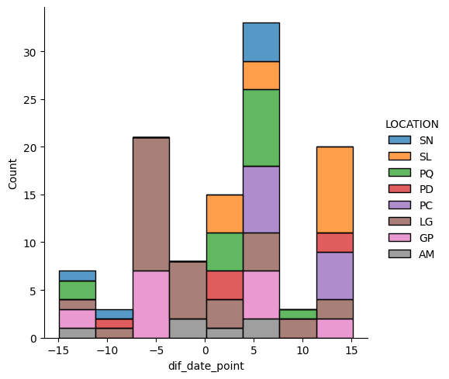
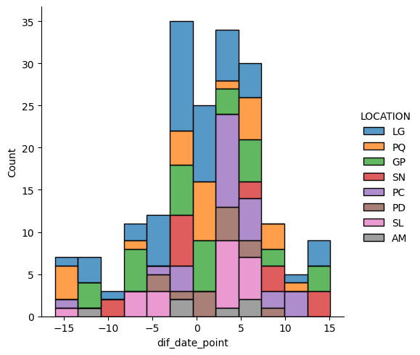
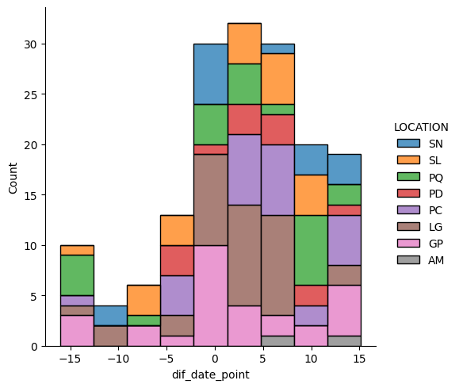
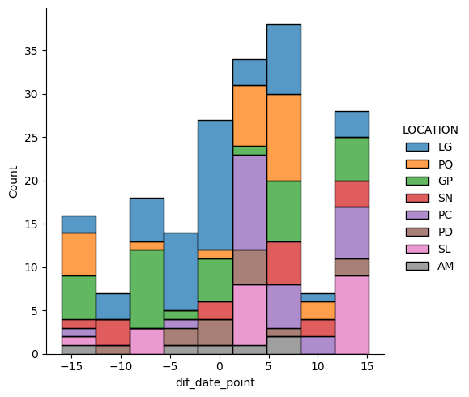
LD8
LD7 + LD8 min date diff
LD7 + LD8
LD8 priority
LD7

Slide 2
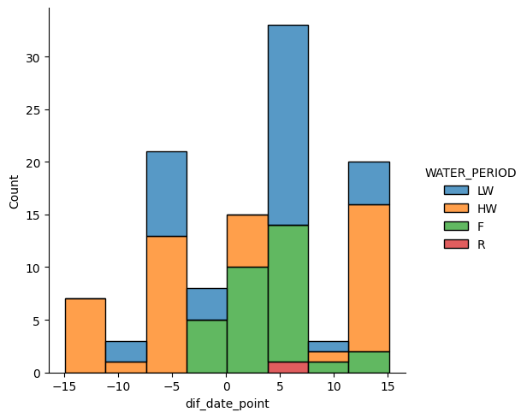
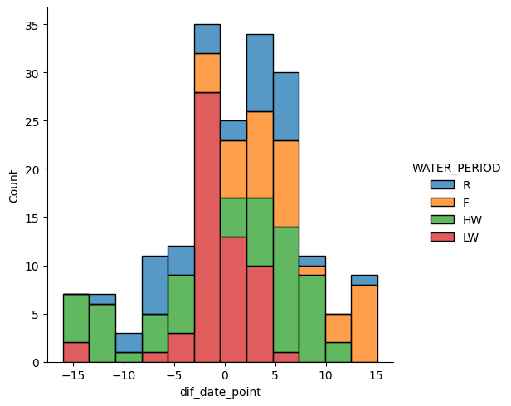
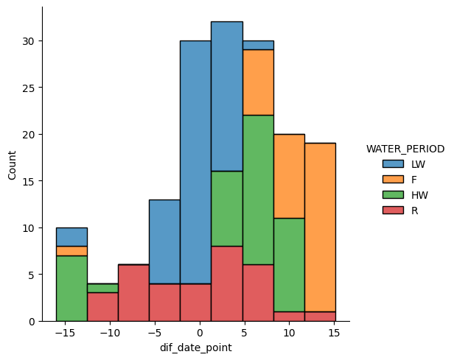
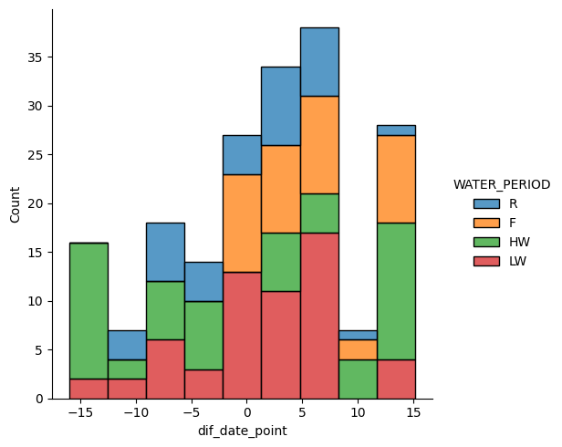
LD8
LD7 + LD8 min date diff
LD7 + LD8
LD8 priority
LD7

Slide 3
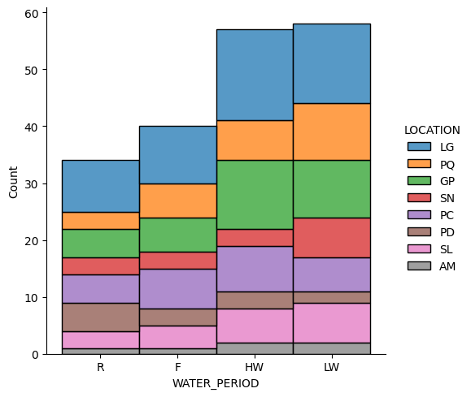
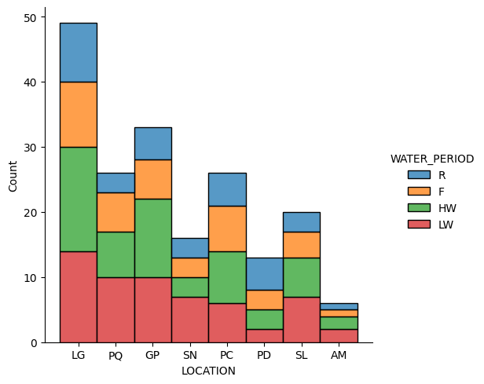
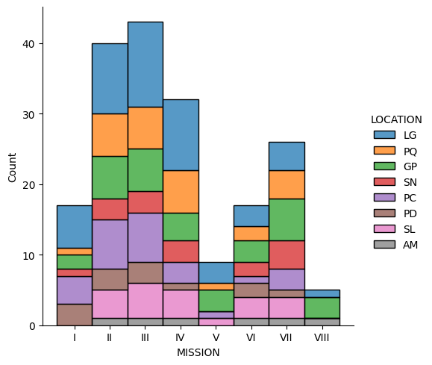
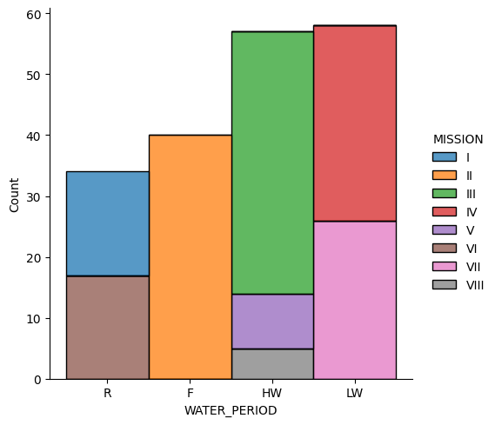

Slide 4
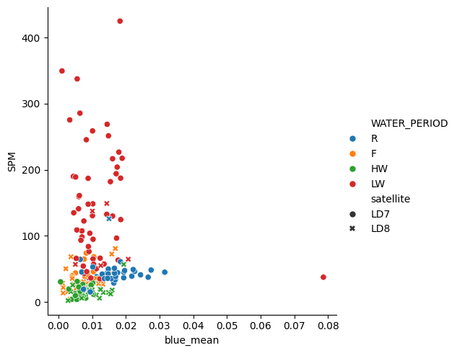
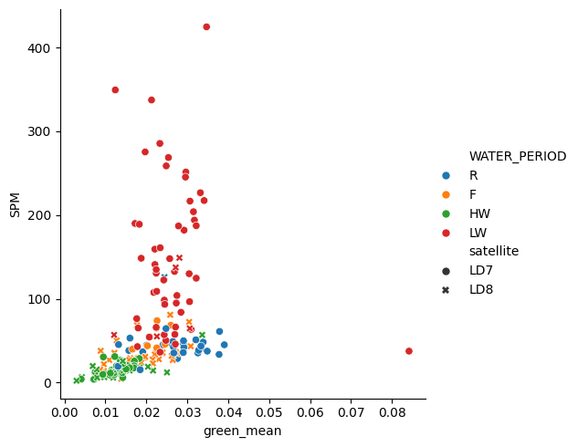
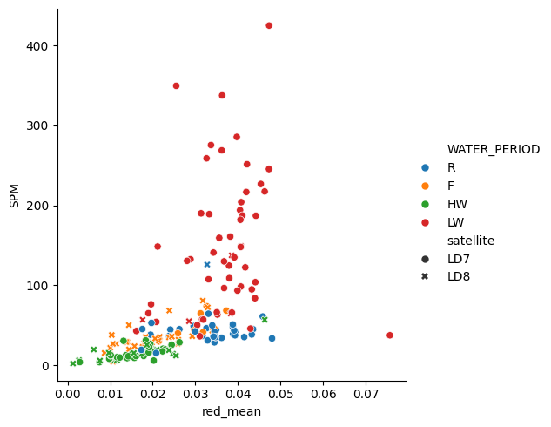
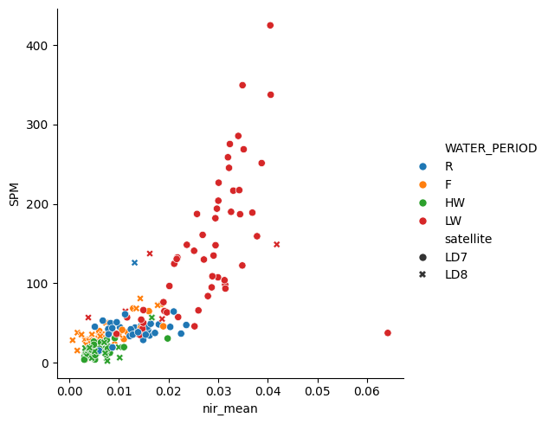
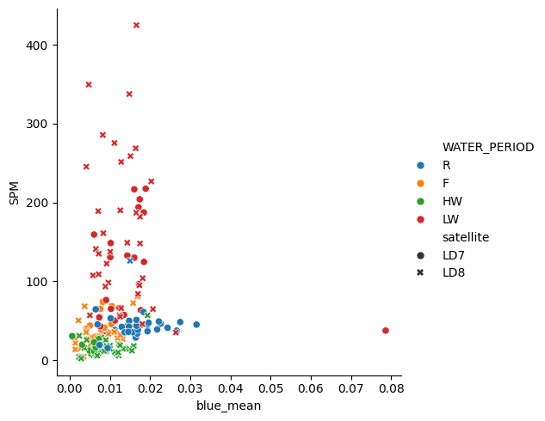

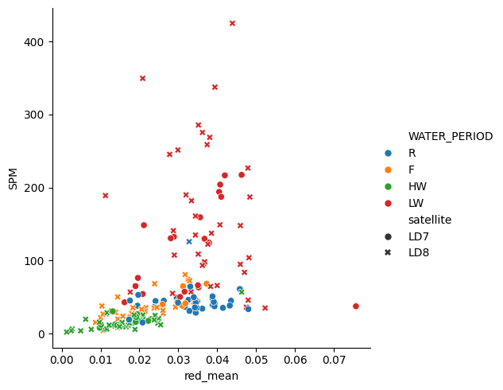
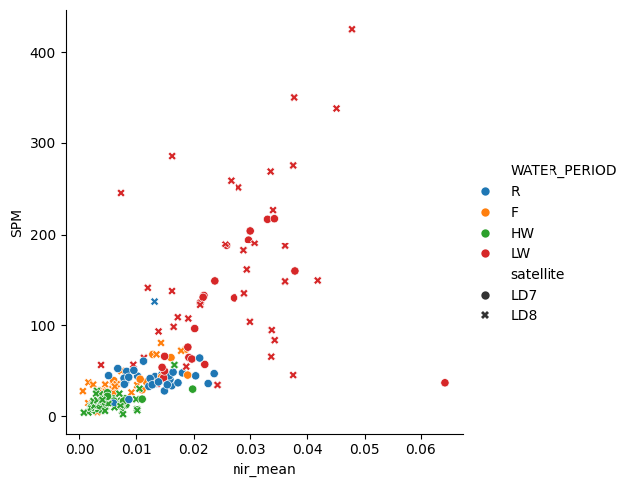
Menor diferença de data entre amostra e imagem
SPM vs média das bandas
Priorizar imagem LD8

Slide 5
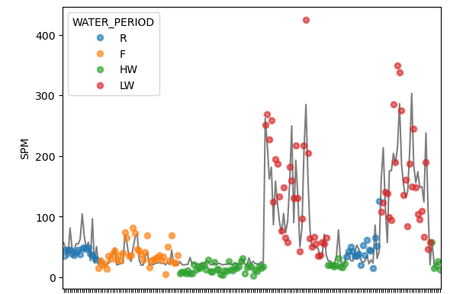
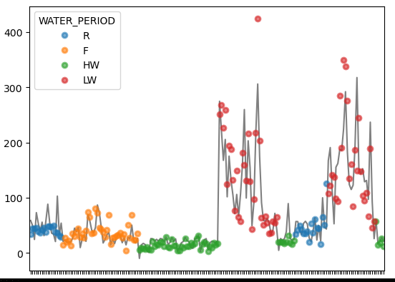
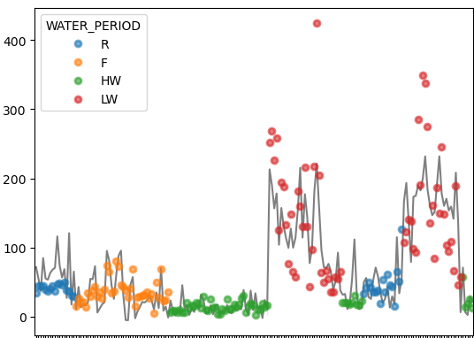
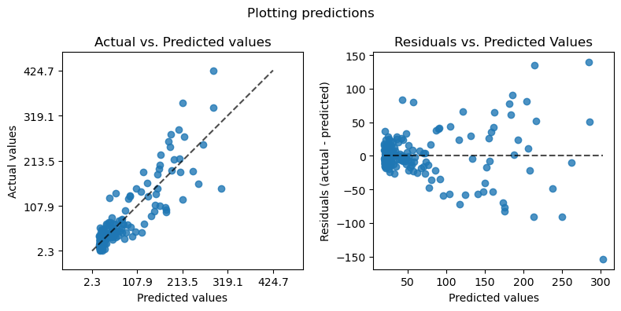
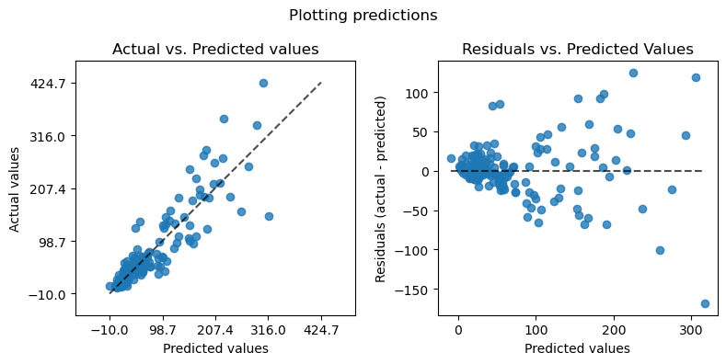
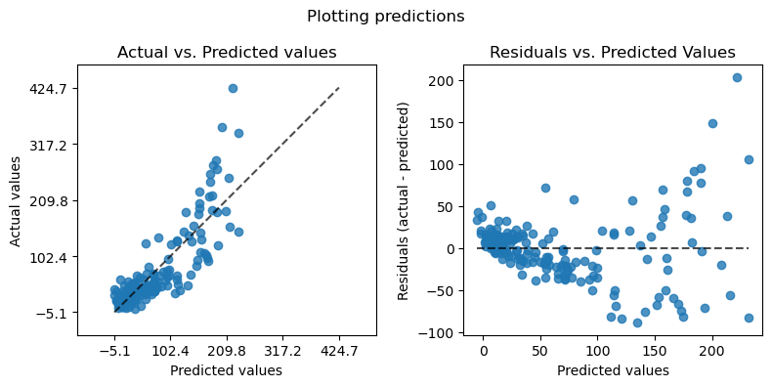
Polinomial NIR
Polinomial multipla
Linear multipla
Metrics: {'r2': 0.7834035765581147, 'mae': 21.709839272638554, 'mse': 1162.4790568439223, 'mape': 0.5680294729945504, 'exp_var': 0.7834035765581147}
Metrics:{'r2': 0.8067844304170517, 'mae': 19.678273162345402, 'mse': 1036.9933608650351, 'mape': 0.4190075349016725, 'exp_var': 0.8067844304170517}
Metrics:{'r2': 0.7312429382255918, 'mae': 25.662056294174953, 'mse': 1442.4266602697803, 'mape': 0.6272036469220751, 'exp_var': 0.7312429382255918}

Slide 6
Machine learning models

Slide 7
Github links to view more data: https://github.com/larissavaladao/py6s_harmonize_sample/
Regressions per water period
Per water period per band

